Slide 1

Project ERDOS
Towards End-to-End Compute Graph Optimization with Graph Neural Networks
Team:
Mohd Tabish Jamal
Nazar Iqbal
Rijin Shaji
Oishi Chatterjee
Raja Shekar Dubaguntla
Sathya Sudha Murugan
Presenter:
Nazar Iqbal
Raja Shekar Dubaguntla
Mentor
Gabriel Campero Durand

Slide 2
Agenda
Device Placement
Review
Papers: Hierarchical, Placeto, Spotlight

Slide 3
Device Placement
In past years, we have huge machine learning models
To run these models, we need more computation power and optimize machine learning models
Runtime can be improved by improving device placement of the computational graph of the models[1]
The goal is to determine how best to assign the nodes of the graph to the physical devices on which it runs such that the end-to-end[1] run time is minimized.

Slide 4
Heuristics and reinforcement Learning
What are heuristics?
Heuristics based algorithms and their drawbacks?
Deep Reinforcement method in place of heuristics based algorithms.

Slide 5
A Hierarchical Model For Device Placement (team from google)
Hierarchical model for device placement
two level architecture
assigns operations to groups
Placer that assigns groups to target devices [5]
Objective: predict a placement that speeds up the training of neural network graphs. [5]
Experiment: Compare our results to heuristic and RL-based graph optimization baselines and demonstrate.
Two simple alternatives i) no grouping, ii) random grouping [5]

Slide 6
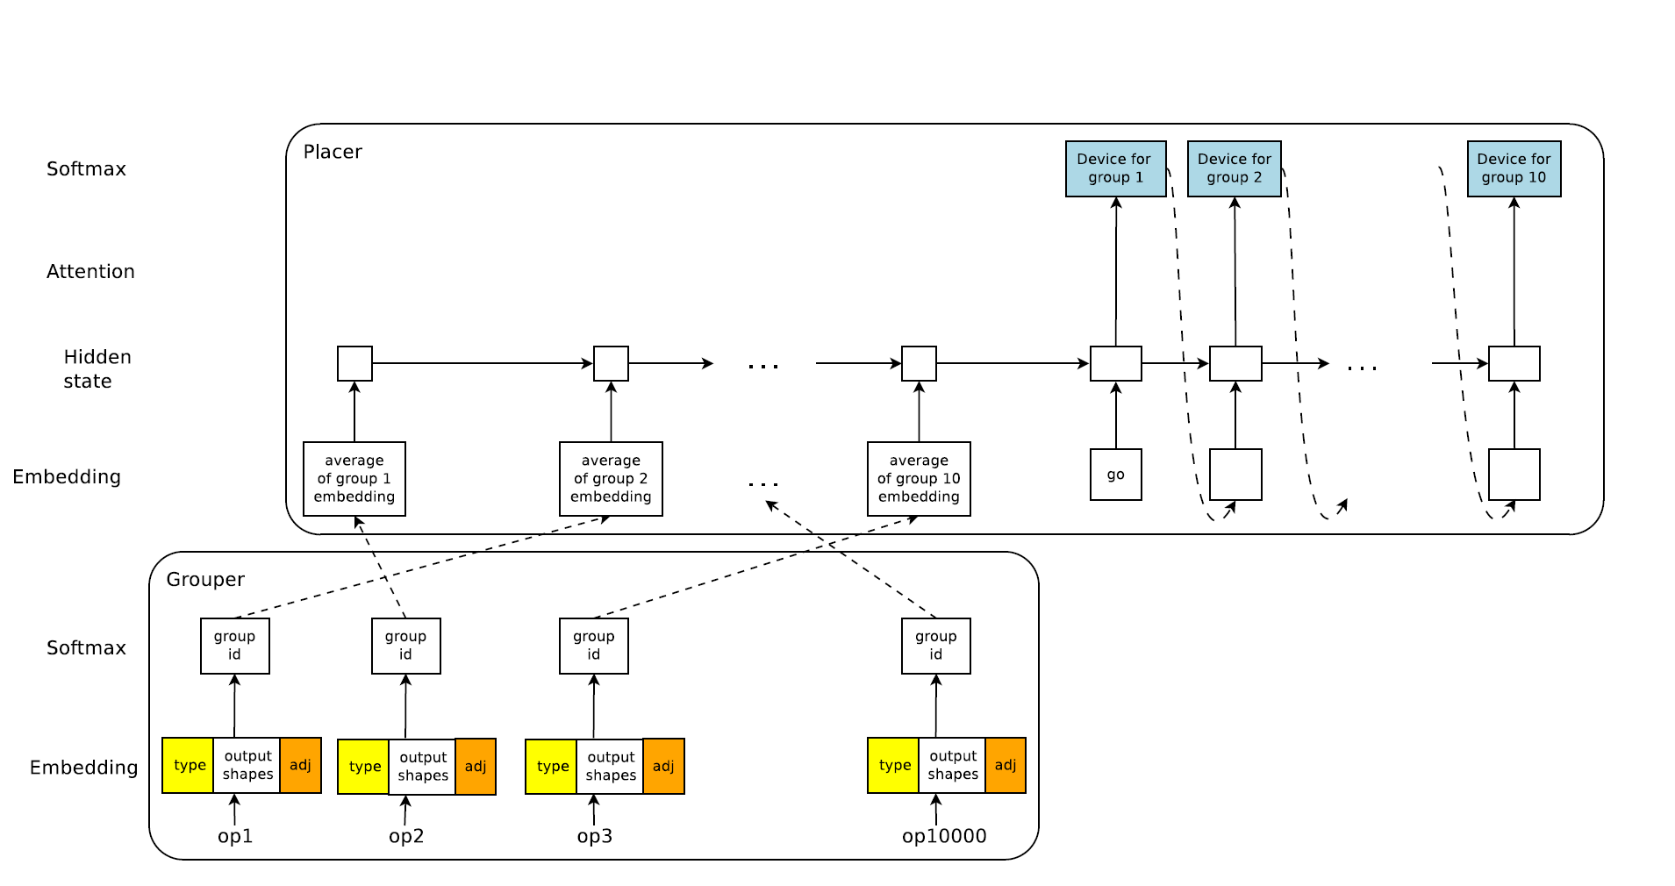
Figure 1: Hierarchical model for device placement [5]

Slide 7
Models: four widely used deep neural networks [5]
Inception-V3
ResNet
RNNLM
NMT
Baselines: [5]
CPU Only
GPU Only
Scotch
MinCut
Human Expert
ColocRL

Slide 8
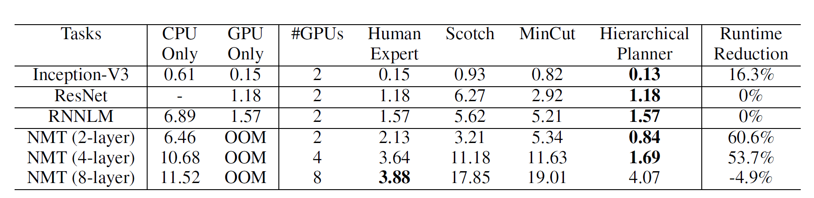
Table 1: Model Runtimes (seconds) for different placements (lower is better). OOM: Out Of Memory.[5]
Disadvantage: 1)Fixed number of groups
2) we have to do the operations separately for each node

Slide 9
Placeto: Learning Generalizable Device Placement Algorithms for Distributed Machine Learning (team from MIT)
Placeto can learn generalizable device placement policies that can be applied to any graph
Proposes two key ideas
Iterative placement improvements.
Graph embeddings [3]
Retraining from scratch every time a new graph is to be placed in avoided [3]

Slide 10
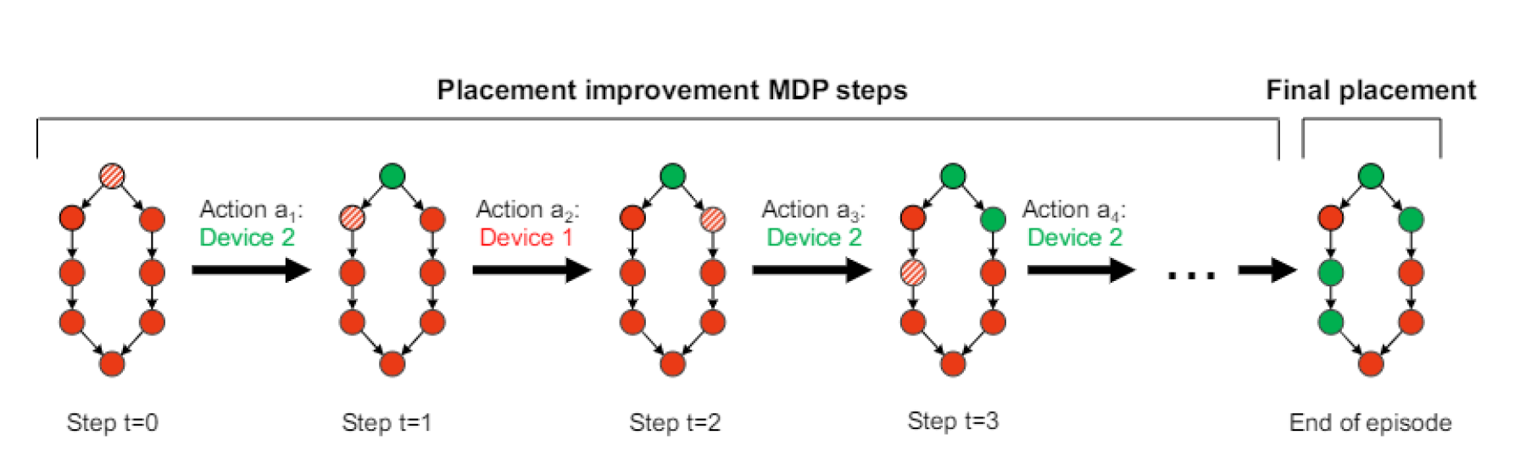
Figure 2: MDP structure of Placeto’s device placement task.
At each step, Placeto updates a placement for a node (shaded) in the computational graph.
These incremental improvements amount to the final placement at end of an MDP episode. [3]

Slide 11
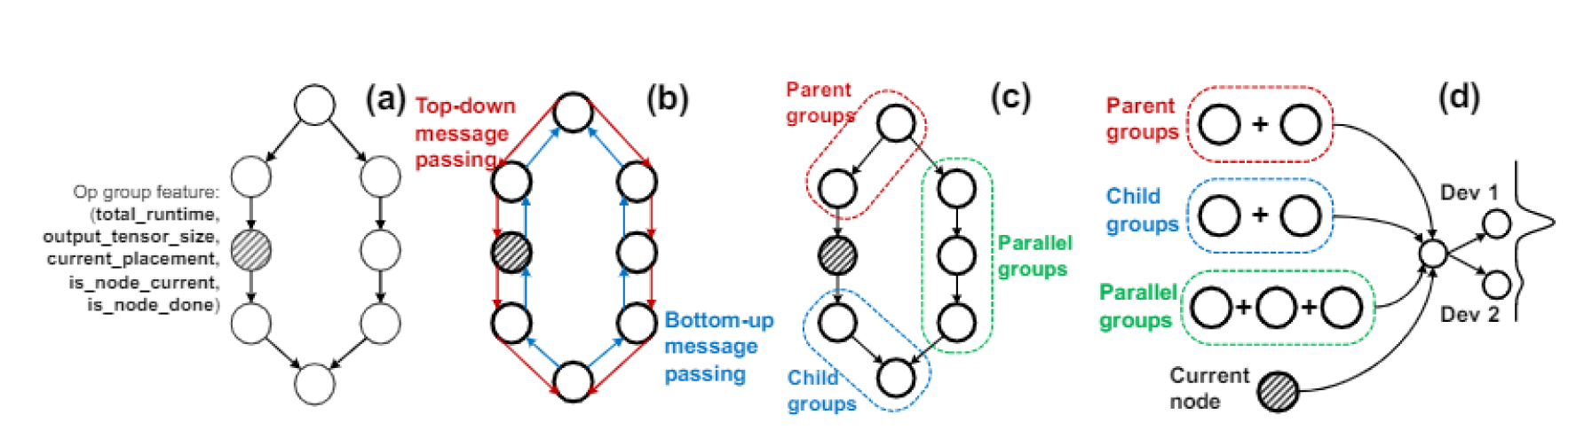
Customised Graph Embedding
Computing pre-group attributes.
Local neighborhood summarization.
Pooling Summaries. [3]
Figure 3: Placeto’s Graph embedding approach. It maps raw features associated with each op group to the device placement action. [3]

Slide 12
Baselines: [3]
Single GPU
Scotch
Human Expert
RNN-based approach
Dataset: [3]
Inception_V3
NMT
NANNet

Slide 13
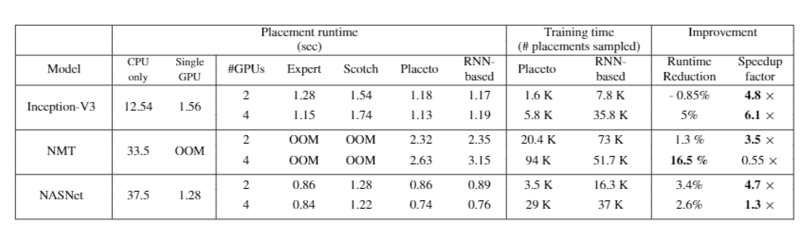
Tabel 2: Running times of placements found by Placeto compared with RNN-based approach [3]
Disadvantage of this method: 1) The intermediate reward is more expensive
2) It is inefficient, as it performs one gradient update for each data sample

Slide 14
Spotlight: Optimising Device Placement for Training Deep Neural Networks
Objective: Training deep neural networks requires a lot of computation resources and it’s essential to use a mixture of GPU & CPU devices.[4]
Markov decision process with multiple stages, we are able to prove that Spotlight achieves a theoretical guarantee on performance improvements.
How to improve the policy gradient method (based on reinforcement learning) to solve the device placement, which is to specify how each operation in a neural network should be matched to each of the CPU and GPU devices?
The standard policy gradient method is known to be inefficient, as it performs one gradient update for each data sample, which results in high training costs due to long time taken to find a placement.[4]

Slide 15
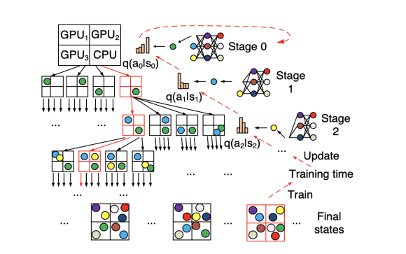
Figure 4. The state tree of a device placement MDP. [4]

Slide 16
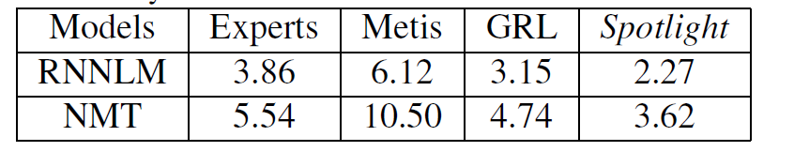
Table 3. Per-step training time (in seconds) of placements given by the baselines for the environment with 4 GPUs. Experts place each LSTM layer on one GPU. [4]
Conclusion: Spotlight in the TensorFlow CIFAR10 image classification benchmark, and deployed it on 10 CPU and GPU nodes in the Google Cloud platform. Spotlight takes only 9 hours on five worker machines to find even better placements than (Mirhoseini et al., 2017), and the training time using the placement found by Spotlight is 60.9% of that obtained from (Mirhoseini et al., 2017). [4]
Disadvantage: high training cost due to long time taken to find a placement.

Slide 17
Device Placement Optimization with Reinforcement Learning[6]
Usually placing of parts of neural model is done by human experts based on simple heuristics and intuitions.
Method which learn to optimize device placement for TensorFlow computational graph.
Sequence to sequence model to predict which operations in a tensorflow graph should run on which of the available devices.
Execution time as reward signal to optimize the parameter of the model.

Slide 18
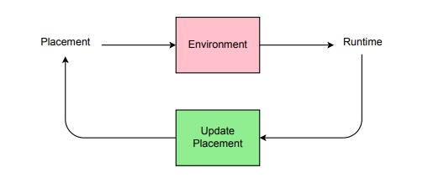
An overview of the RL based device placement model.
Figure 5. An overview of the RL based device placement model.[6]

Slide 19
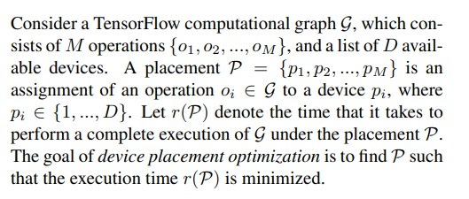
Method[6]

Slide 20
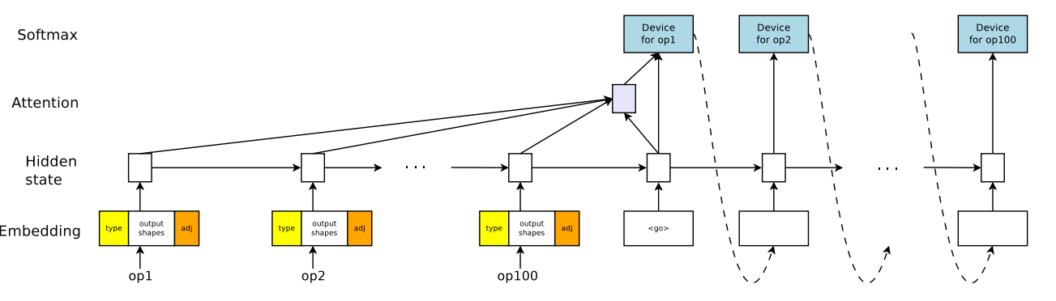
Model
Figure 6. Device placement model architecture.[6]

Slide 21
Transferable Graph Optimizers for ML Compilers[1]
Introduction.
In mapping a computational graph to machine code that executes on a collection of devices, ML compilers need to solve many optimization problems including graph rewriting, assignment of operations on devices, operation fusion, layout and tiling of tensors, and scheduling. ML compilers usually apply heuristics to solve these problems individually, which has limitations
Heuristics leads to sub-optimal solutions.
By solving these problems in isolation, the compiler misses out on opportunities for joint optimizations across tasks.

Slide 22
Tasks and Problem Formulation[1]
Device Placement
Given a computational graph, the goal of device placement is to learn a policy π:G -> D that assigns a device d∈D for all nodes in the given graph g∈G, to maximize a reward r_{g;d} defined based on the run time.
Operation Scheduling
An op in a dataflow graph is ready to run when its incoming tensors are present in the device memory. A frequently used scheduling strategy is to maintain a ready queue of operations for each device and schedule operations in first-in-first-out order.
Generalization across graphs
The training objective for GO is to simultaneously reduce the expected run time of the optimization over multiple dataflow graphs.
Joint optimization across tasks
This method can be extended to handle multiple tasks jointly.

Slide 23
Generalization with Parameter Superposition[1]
One of the goals discussed is to ensure the generalizability of the the policy network over a wide variety of graphs from potentially different application domains (e.g. computer vision, language, and speech).Not only do these graphs vary in the number of operations from a few thousand to a million, but they also have drastically different network architectures
To overcome this limitation, a feature modulation mechanism similar to parameter superposition is used . The idea is to re-weight network parameters by generating a feature modulation layer based on the input graph features , to mitigate the potentially undesirable interference among different input graphs.

Slide 24
Multi-task Policy[1]
We propose a recurrent attention policy network that not only applies a segment level recurrent attention to the graph representation spatially, but also generates recurrent actions for multiple tasks through residual connections and parameter sharing across multiple recurrent attention layers.
Conclusion
In this paper, we present a generalized deep RL method for computation graph optimizations that generalizes to arbitrary and held out graphs. We propose recurrent attention layers to jointly optimize dependent graph optimization tasks and demonstrate 33%-60% speedup over TensorFlow’s default strategy on three tasks.

Slide 25
Research Questions:
RQ 1: To what extent does the performance of models(MoNet, GAT, Gated GCN, and Gated GCN-PE) improve by changing the Parameter Configuration on traditional Node Classification Datasets such as Pattern and Cluster.
RQ 2: To what extent does the performance of these models(MoNet, GAT, Gated GCN, and Gated GCN-PE) improve the Classification task on Dataset of Machine Learning Computation Graphs for Device Placement.
Long term Goal: Optimize the Databases with Deep Reinforcement Learning that uses Graph Neural Network.

Slide 26
Next Steps:
Test the Graph neural network models on single data sets
Find the best configuration
That we are doing in Normal Dataset and R-Dataset

Slide 27
References
Zhou, Yanqi, Sudip Roy, Amirali Abdolrashidi, Daniel Wong, Peter Ma, Qiumin Xu, Hanxiao Liu et al. "Transferable graph optimizers for ml compilers." arXiv preprint arXiv:2010.12438 (2020).
Chen, Xinyun, and Yuandong Tian. "Learning to perform local rewriting for combinatorial optimization." Advances in Neural Information Processing Systems 32 (2019): 6281-6292.
Ravichandra Addanki, Shaileshh Bojja Venkatakrishnan, Shreyan Gupta, Hongzi Mao, and Mohammad Alizadeh. Placeto: Learning generalizable device placement algorithms for distributed machine learning.CoRR, abs/1906.08879, 2019

Slide 28
Yuanxiang Gao, Li Chen, and Baochun Li. Spotlight: Optimizing device placement for training deep neural networks. In Jennifer Dy and Andreas Krause, editors,Proceedings of the 35th International Conference on Machine Learning, volume 80 of Proceedings of Machine Learning Research, pages 1676–1684, Stockholmsmässan, Stockholm Sweden, 10–15 Jul 2018. PMLR
Azalia Mirhoseini, Anna Goldie, Hieu Pham, Benoit Steiner, Quoc V. Le, and Jeff Dean. Ahierarchical model for device placement.ICLR, 2018.
Mirhoseini, Azalia, Hieu Pham, Quoc V. Le, Benoit Steiner, Rasmus Larsen, Yuefeng Zhou, Naveen Kumar, Mohammad Norouzi, Samy Bengio, and Jeff Dean. "Device placement optimization with reinforcement learning." In International Conference on Machine Learning, pp. 2430-2439. PMLR, 2017.

Slide 29
Thank you.

